Slide 1
Encoding cognitive parameters from single cell activity
Hugo Merchant
Instituto de Neurobiología, UNAM, México.

Slide 2
Cognitive Neuroscience/ System Neurophysiology
Cognitive Neuroscience: The study of the relationships between neuroscience and cognitive psychology, especially regarding memory, sensation and perception, problem solving, language processing, motor functions and abstraction.
All cognition is the result of neurophysiological activity
Most closely linked to neural ensemble interactions within the cerebral cortex

Slide 3
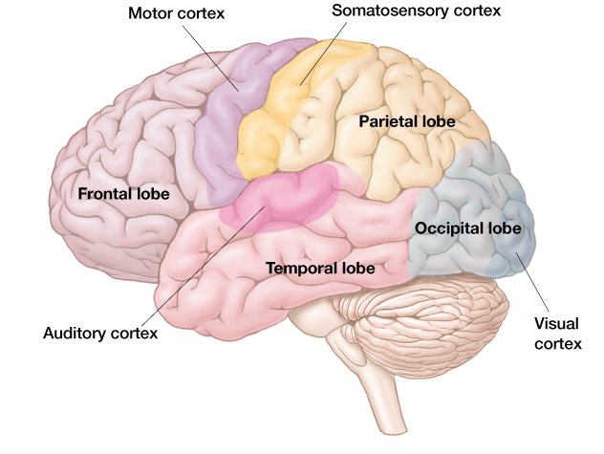
Cerebral Cortex of the Human

Slide 4
Major regions of cerebral cortex
frontal lobes - motor activity, planning & moving, processing of affective info., spoken language (Broca' s area), creative thinking, executive control
temporal lobes - audition, language perception (Wernicke' s area) , memory, emotion and auditory cortex
parietal lobes - somatosensation, spatial perception, multimodal integration, attention
occipital lobes - vision

Slide 5
Neural basis of cognition
Can be studied at three levels of description…
a) Single cell: one or a small collection of individual neurons
b) Area-based: a large number of neurons that serve a similar function (localization of function); usually referred to by a collective name (e.g., motor cortex, hippocampus, etc.)
c) Neural systems: dynamic interactions between large neuronal groups within and between cortical and subcortical structures

Slide 6
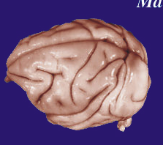
Rhesus Monkey: an excellent animal-model to study cognition
University of Wisconsin-Madison
Brain Collection

Slide 7
Methods in System Neurophysiology
Train Rhesus macaques on perceptual, cognitive, and/or motor tasks
Perform psychophysical tests after training
Record the neural activity using single electrodes or, more recently, multielectrode arrays in connected regions of the brain

Slide 8
Training monkeys in perceptual, cognitive and/or motor tasks
Use operant conditioning to train monkeys to associate the rules between the stimulus presentation and the motor output to get a reward
Use psychophysics to characterize behavior and compare the perceptual, cognitive, and motor abilities between humans and monkeys
The limits in psychophysical performance of the monkeys can be compared on a trial-by-trial basis with the activity of neural populations simultaneously recorded in different brain areas
Very powerful experimental approach: excellent temporal and spatial resolution to study cognition

Slide 9
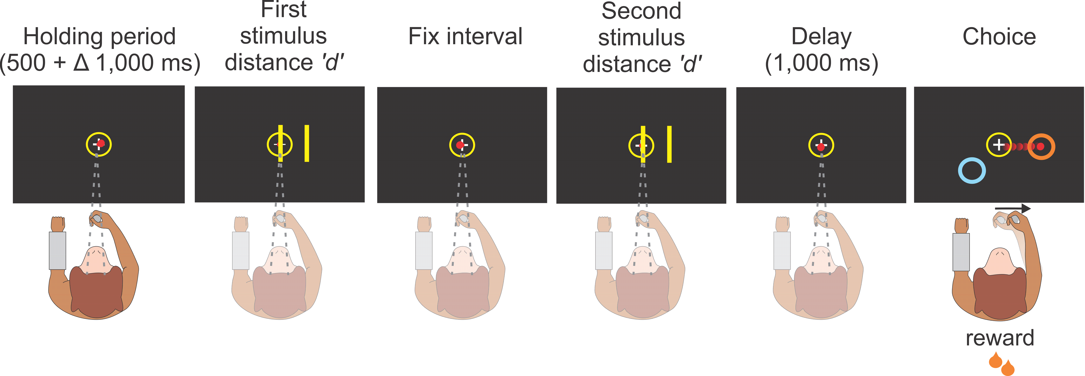
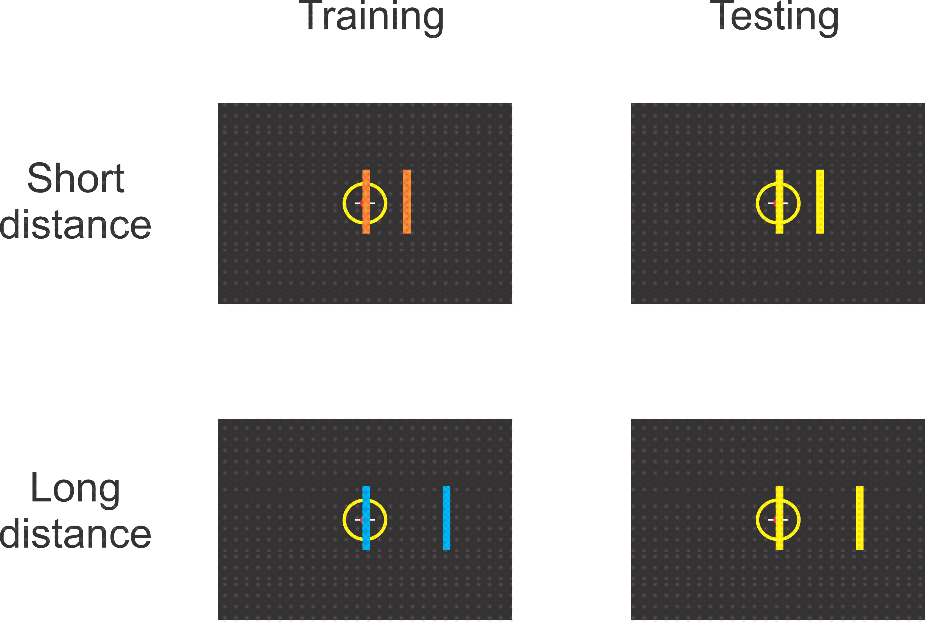
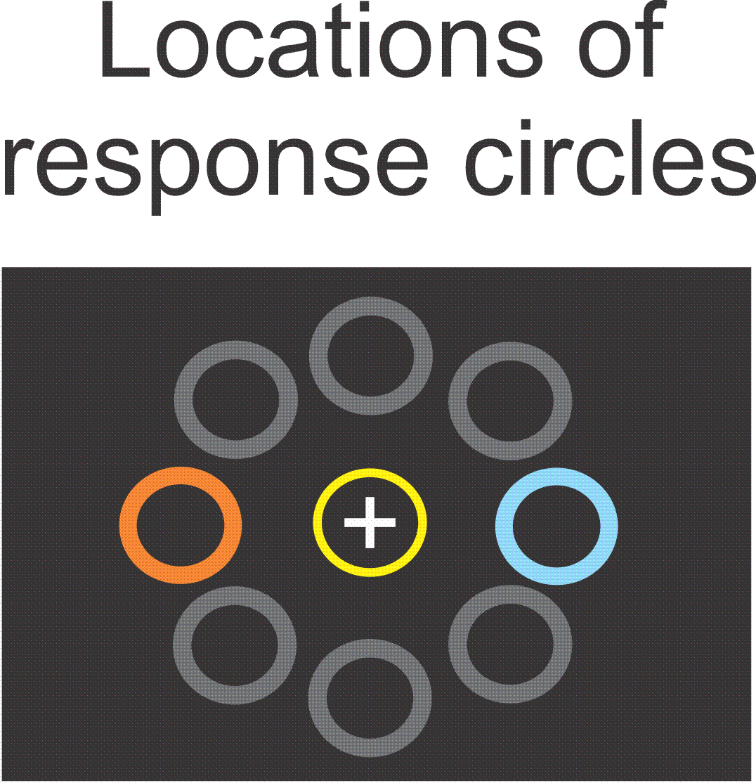
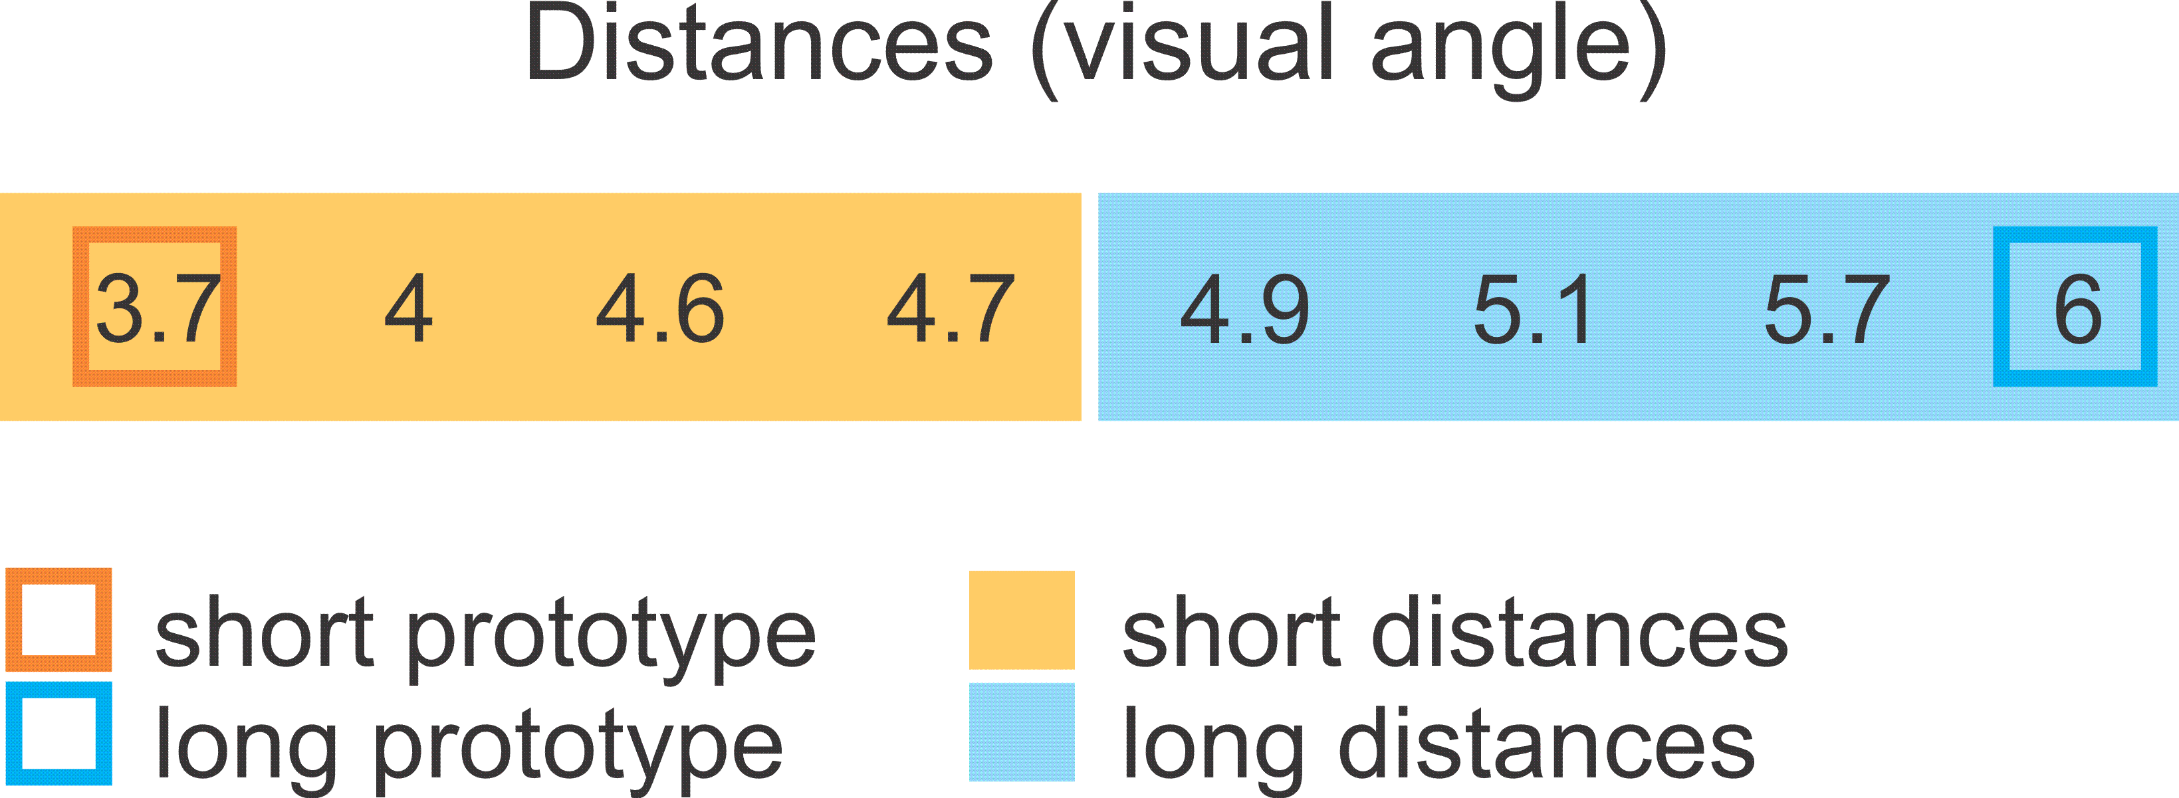
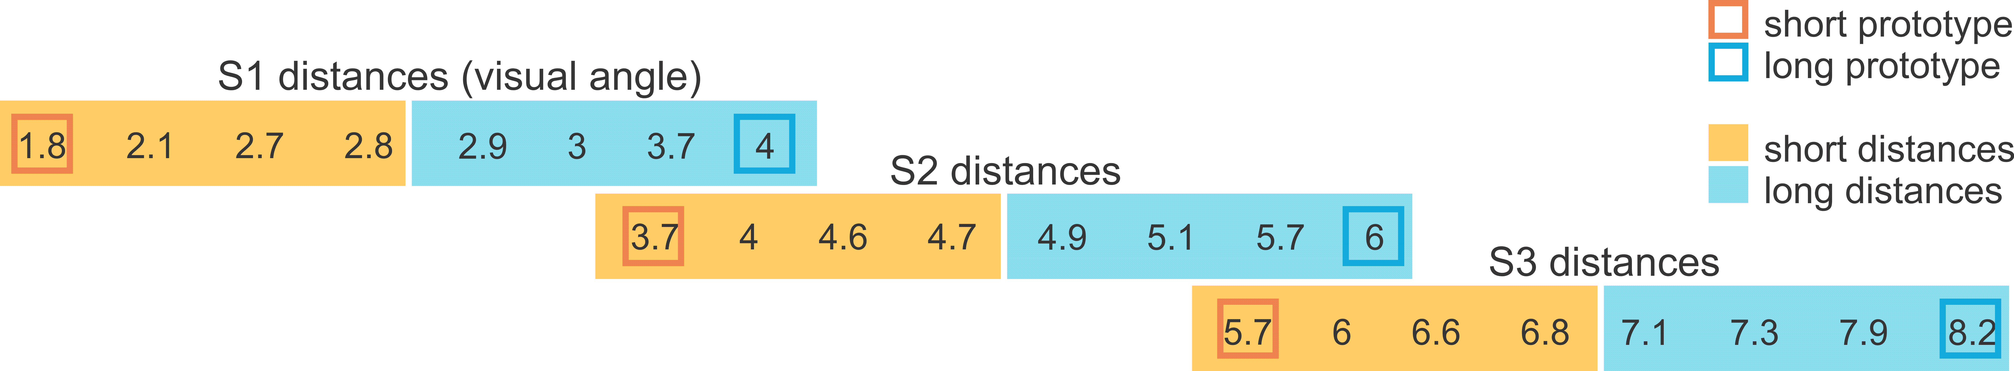
Categorization of Spatial and Temporal Magnitudes

Slide 10
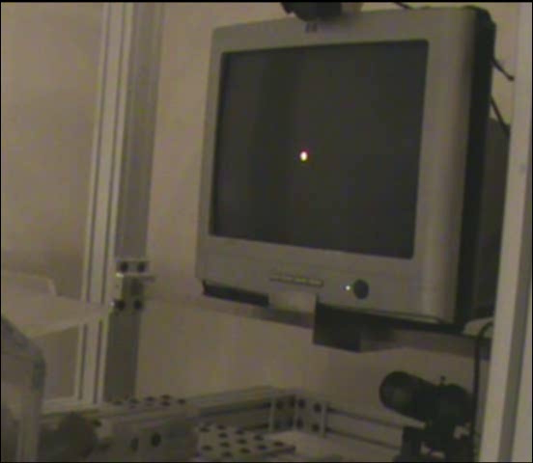
Spatial task
Notes:
This video shows the performance of monkey 1 in the spatial task, where the first trials correspond to the training phase in which the blue stimuli were associated with the long distance prototype and the blue response target, and the orange stimuli were associated with the short prototype and the orange response target. The monkey was cued with yellow stimuli for the spatial tasks in the testing phase.

Slide 11
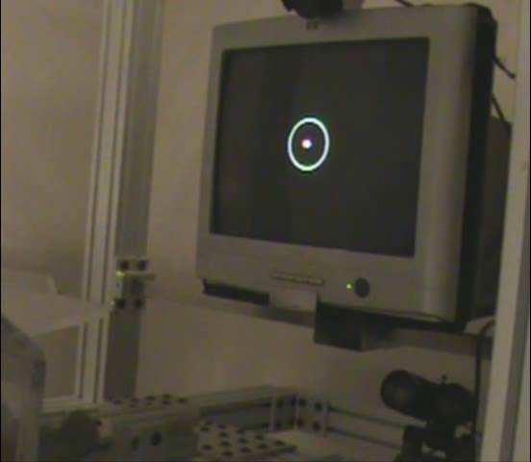
Temporal task
Notes:
This video shows the performance of monkey 1 in the temporal task during the testing phase, where the short inter flash duration was associated with the short category and the orange response target, whereas the long inter stimulus duration with the blue target and the long category.

Slide 12
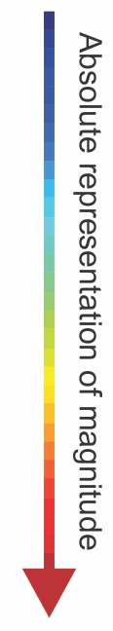
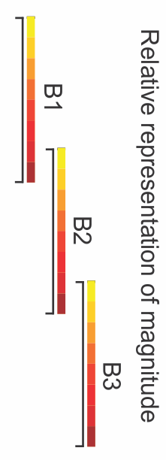
Stimuli
Milliseconds
T1
200
250
319
331
369
381 | T2
450 | 450
500 | 500
 | 619
 | 669
 | 706
 | 756 | T3
 | 870 | 870
 | 920 | 920
 |  | 981
 |  | 1169
 |  | 1231
 |  | 1419
 |  | 1470
 |  | 1520
Mendez et al., 2011

Slide 13
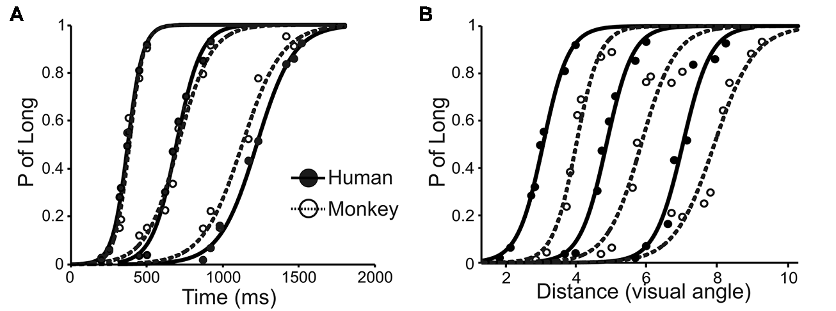
Comparing the relative thresholds between humans and monkeys
Mendez et al., 2011
Mendez, et al., Front Integr Neurosci., 2014

Slide 14
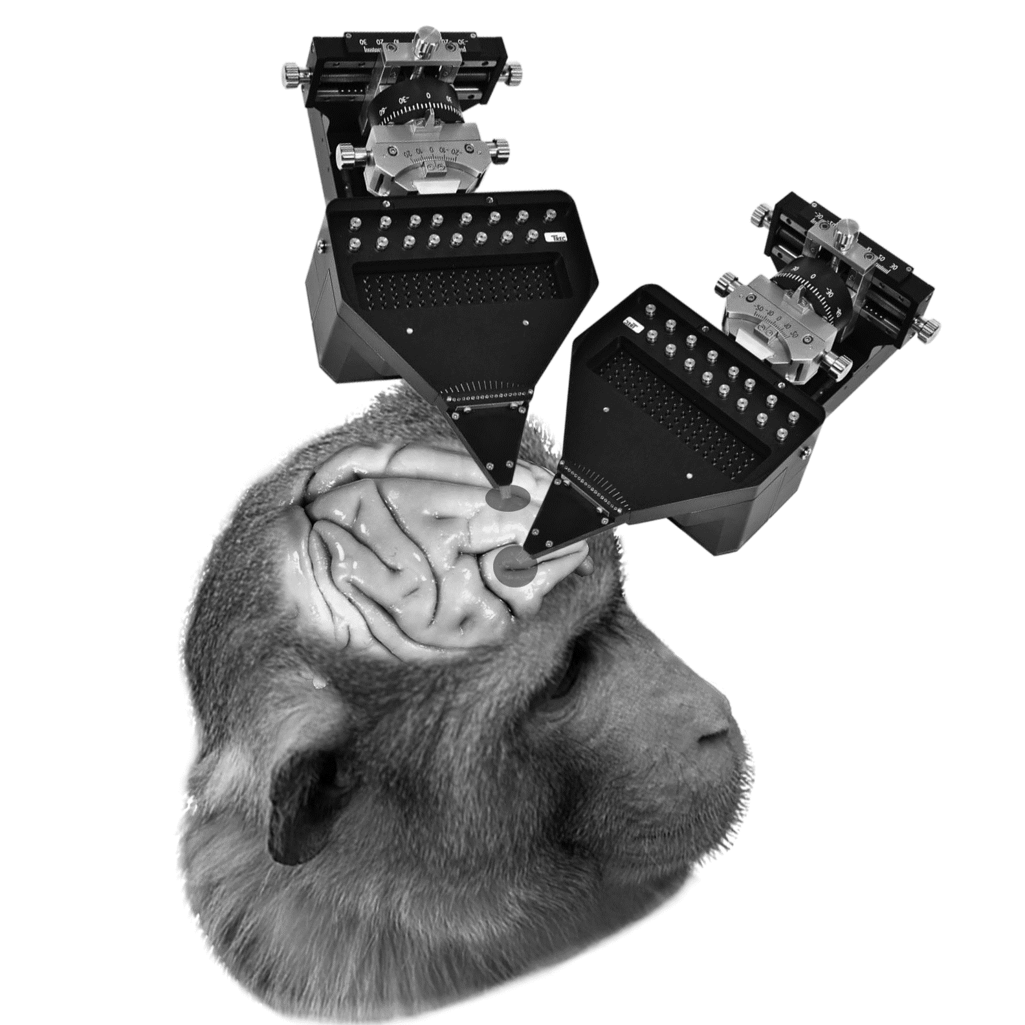
Simultaneous recordings in PFC and pre-SMA
16 electrode recording matrix
Pre-SMA
PFC

Slide 15
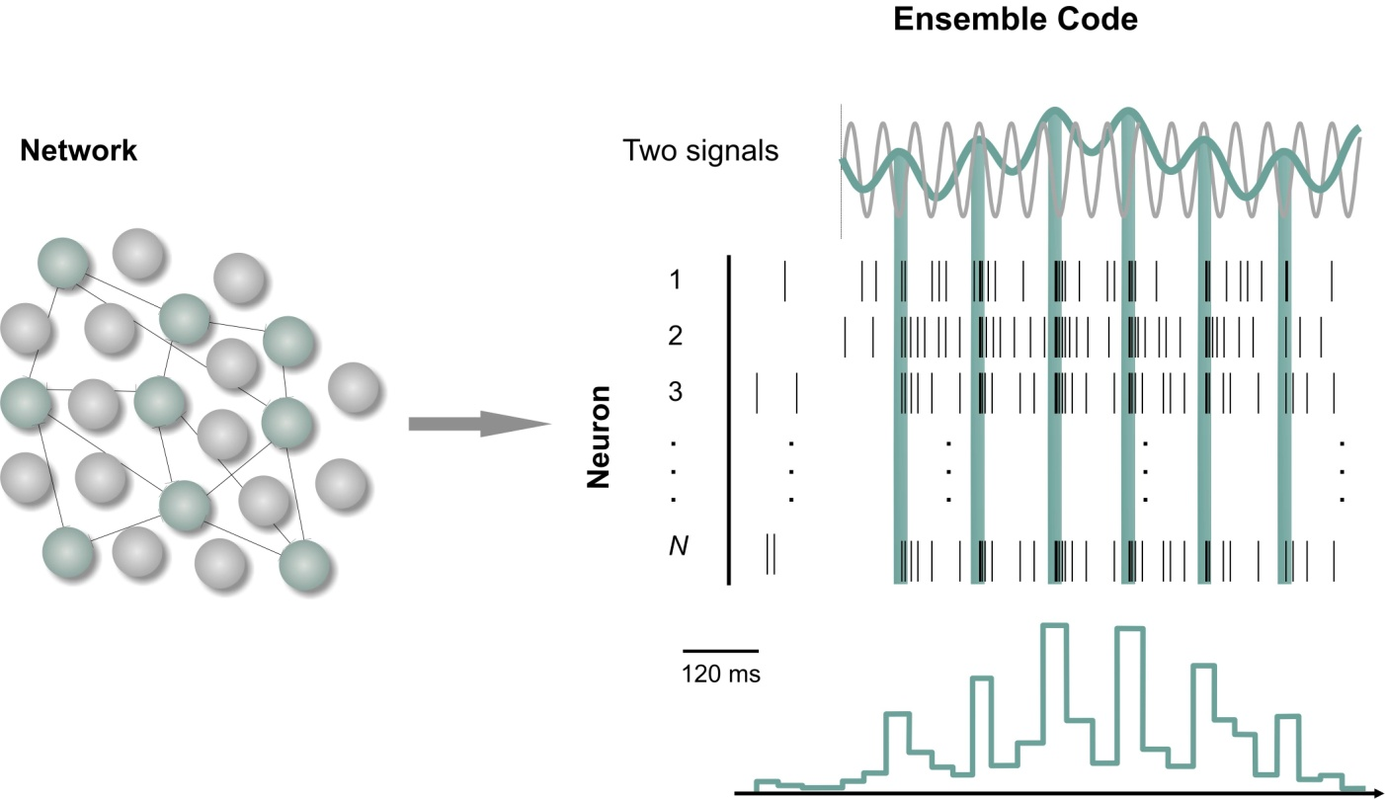
Simultaneously recorded cell analysis : network code, network dynamics
Zarco & Merchant, 2009

Slide 16
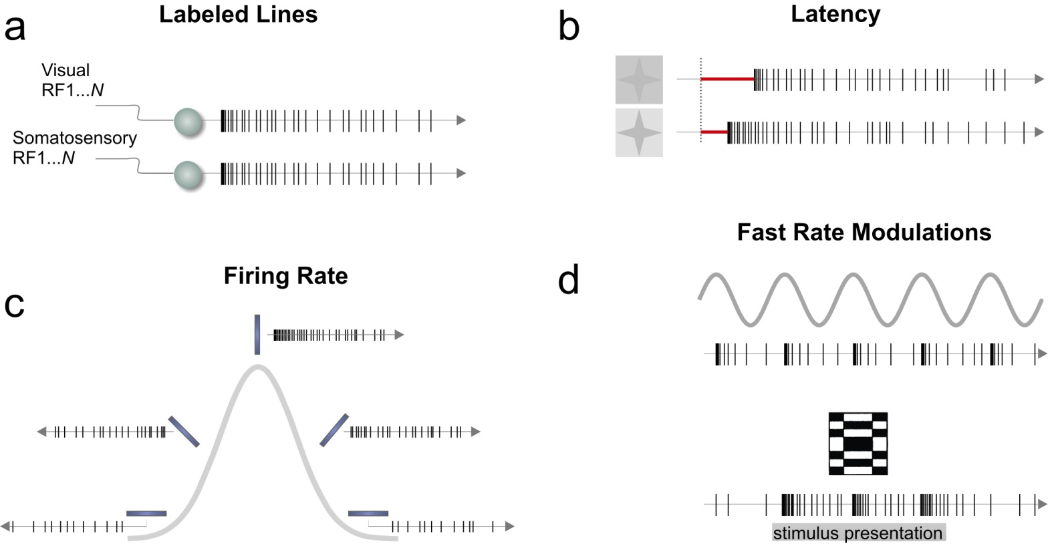
Single Neuron Analysis: neural code
Zarco & Merchant, 2009

Slide 17
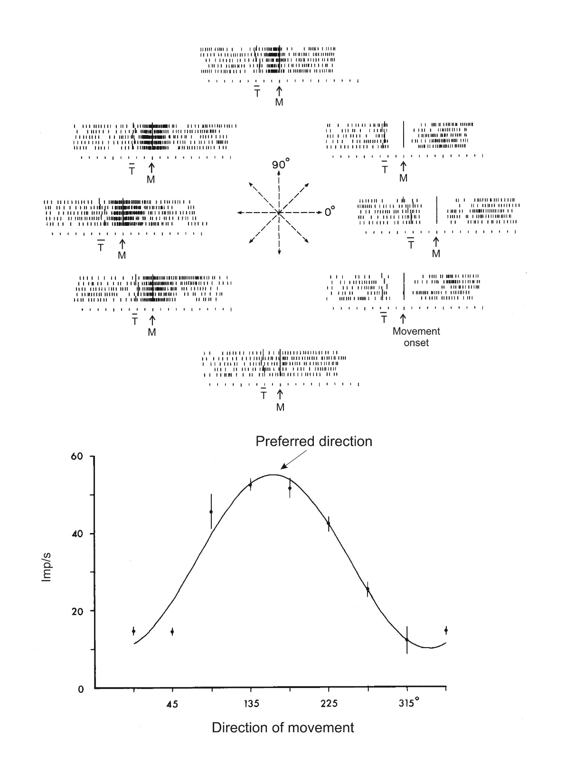
Directional tuning: 2-D
Georgopoulos et al. 1982

Slide 18
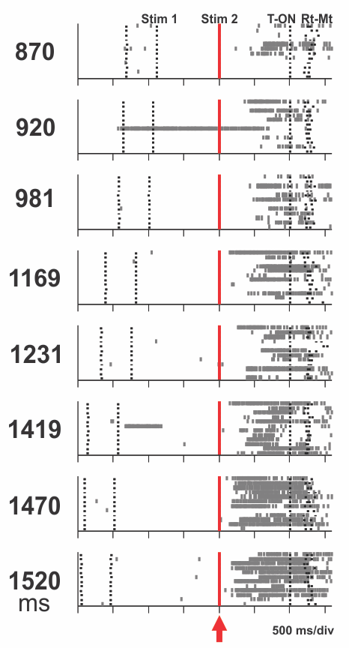
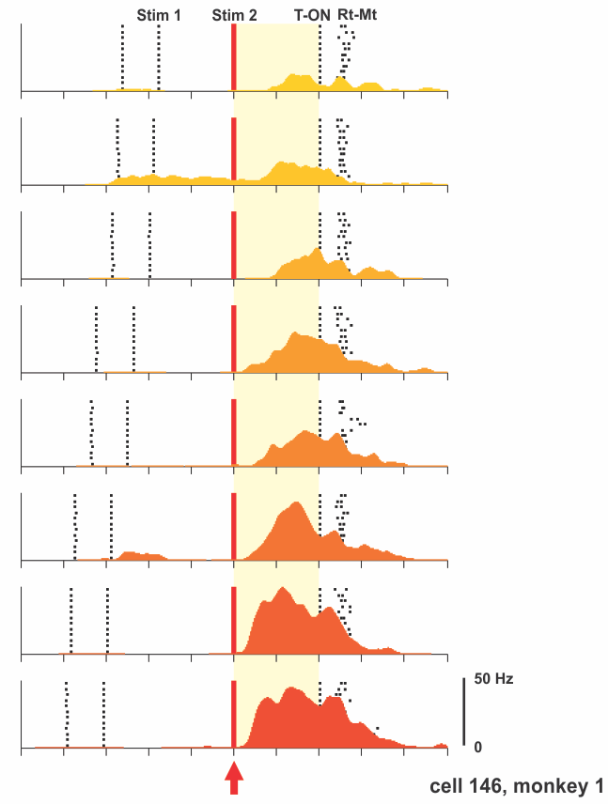
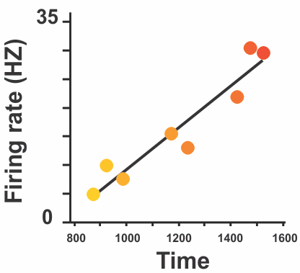
Single Neuron Analysis
First step: analysis of individual recorded neurons
Commonly used: raster plots and spike density functions
These figures graph individual firing patterns over time so that they may be correlated to either a stimulus or behavioral event.
Merchant et al., 2019, in preparation

Slide 19
Neural Encoding

Slide 20
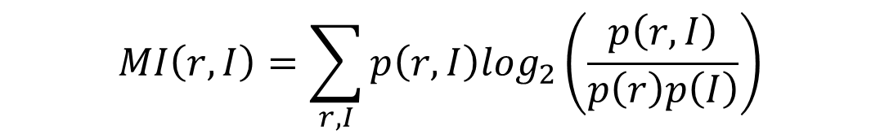
Mutual information
The mutual information (MI) is a measure of the statistical dependency between the behavioral variable (i.e., distance, n = 8) and a neurophysiological parameter (i.e., the discharge rate). MI of the cell’s firing rate and the behavioral parameter (I) is computed as follows:
$$MI\left(r,I\right)=\sum_{r,I}{p\left(r,I\right)\log_{2}\left(\frac{p\left(r,I\right)}{p\left(r\right)p\left(I\right)}\right)}$$
where p(r, I ) is the joint probability of r and I, p(r) is the probability of a particular spike rate across all rates for that cell, and p(I) is the probability of distance in the categorization task: 0.125 (1/8). The overall probability p(r) of observing the r value was obtained by marginalization: p(r)= ∑_{I}(r,I) .

Slide 21
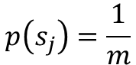
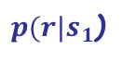
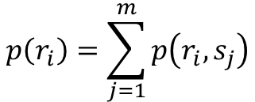
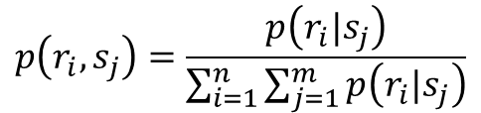
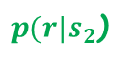
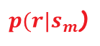
Conditional probability
$$r_{1}$$
hist(Data)
$$r_{2}$$
$$r_{n}$$
$p(r|s_{1}$)
$p(r|s_{2}$)
$p(r|s_{m}$)
Prior probability
Joint probability
Marginal probabilities
$$p\left(s_{j}\right)=\frac{1}{m}$$
$$p\left(r_{i},s_{j}\right)=\frac{p\left(r_{i}|s_{j}\right)}{\sum_{i=1}^{n}{\sum_{j=1}^{m}{p\left(r_{i}|s_{j}\right)}}}$$
$$p\left(r_{i}\right)=\sum_{j=1}^{m}{p\left(r_{i},s_{j}\right)}$$

Slide 22
Matlab Code: Mutual Information
function MI = MutualInformation(Data)
% Input:
% Data is k x m matrix that correspond to k trials per m stimuli
% Output:
% MI is mutual information
% Response Binning
MinData = min(Data(:));
MaxData = max(Data(:));
[k, m] = size(Data);
n = round(sqrt(k*m));
Bin = MinData: (MaxData-MinData)/(n-1): MaxData;
% Conditional probability
pr_s = hist(Data, Bin);
% Joint Probability
prs = pr_s / sum(pr_s(:));
% Rectification
prs(prs < 1e-10) = 1e-10;
prs = prs / sum(prs(:));
% Plot of joint probability
plot(Bin, prs, 'linewidth', 2)
xlabel('Stimuli')
ylabel('p(r,s)')
title('Joint Probability’)
% Prior probability
ps = ones(1, m) / m;
% Marginal probability p(x)
pr = sum(prs, 2);
% Mutual Information matrix
MI_Mat = prs .* log2(prs./(pr*ps));
MI = sum(MI_Mat(:));

Slide 23
Curve Fitting

Slide 24
Raster and SDF

Slide 25
Fitting models

Slide 26
Residual analysis

Slide 27
Best model using MSE

Slide 28
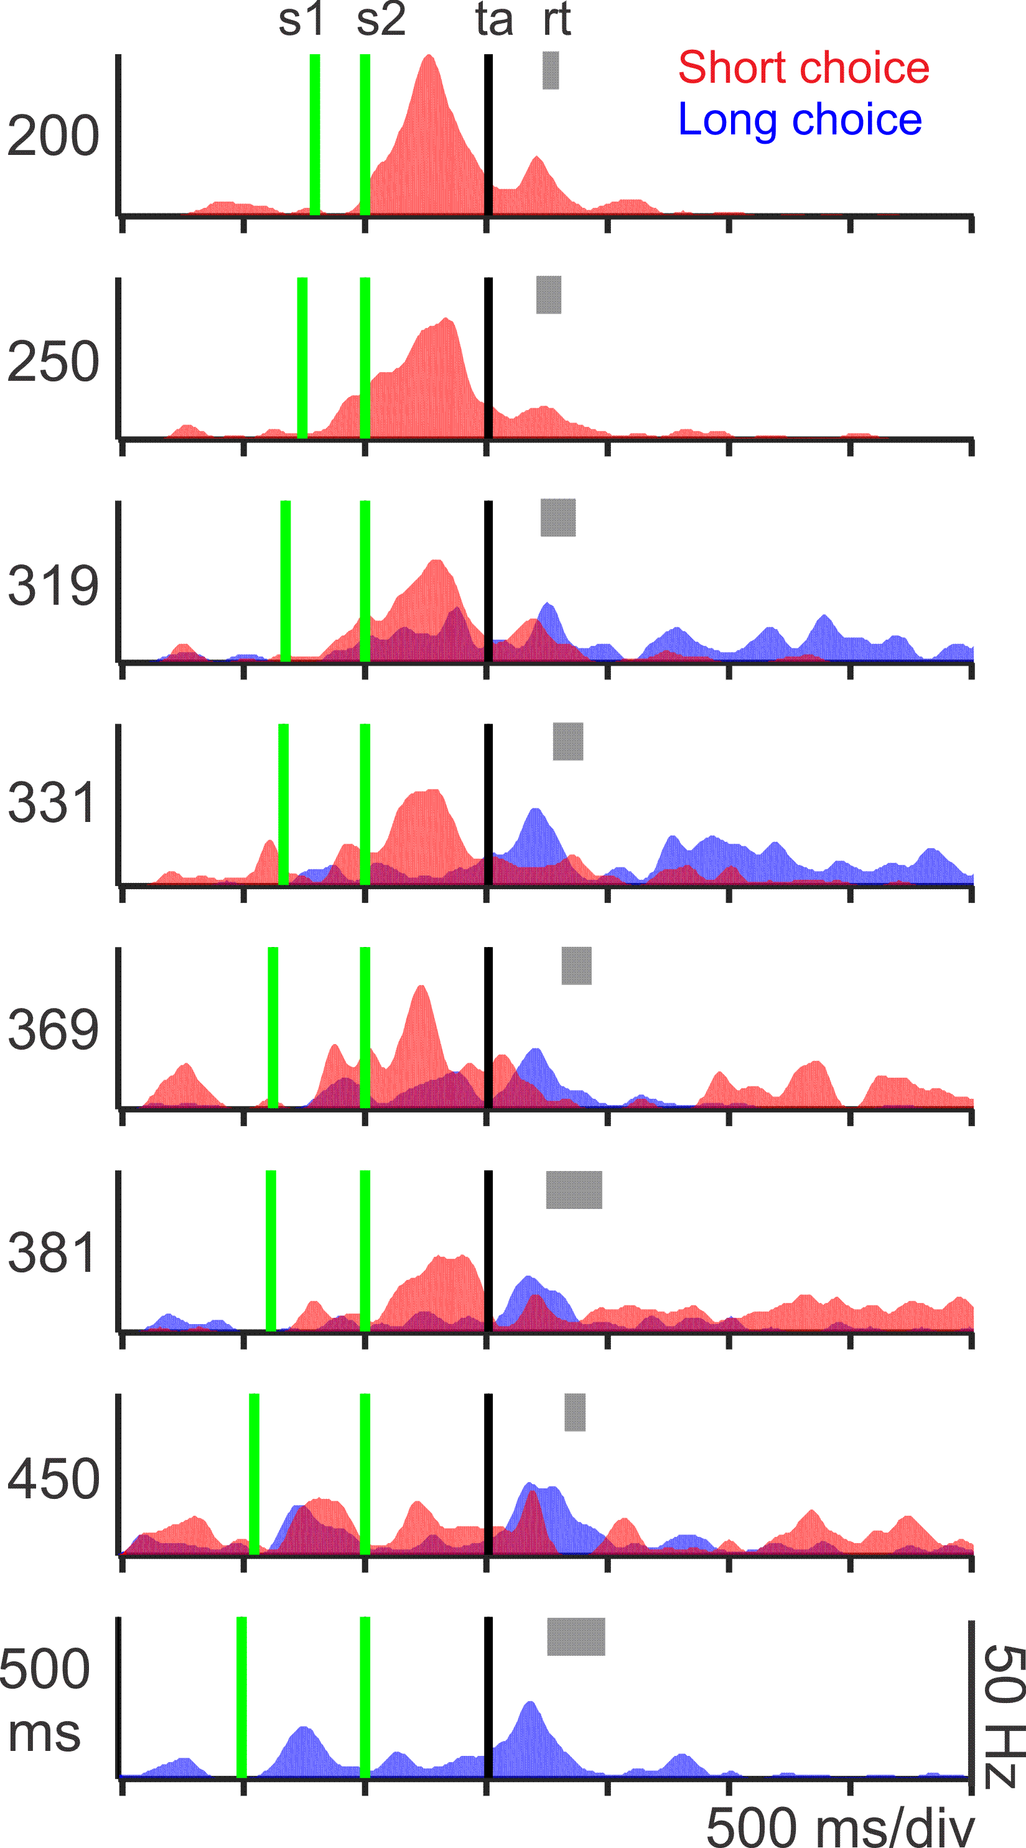
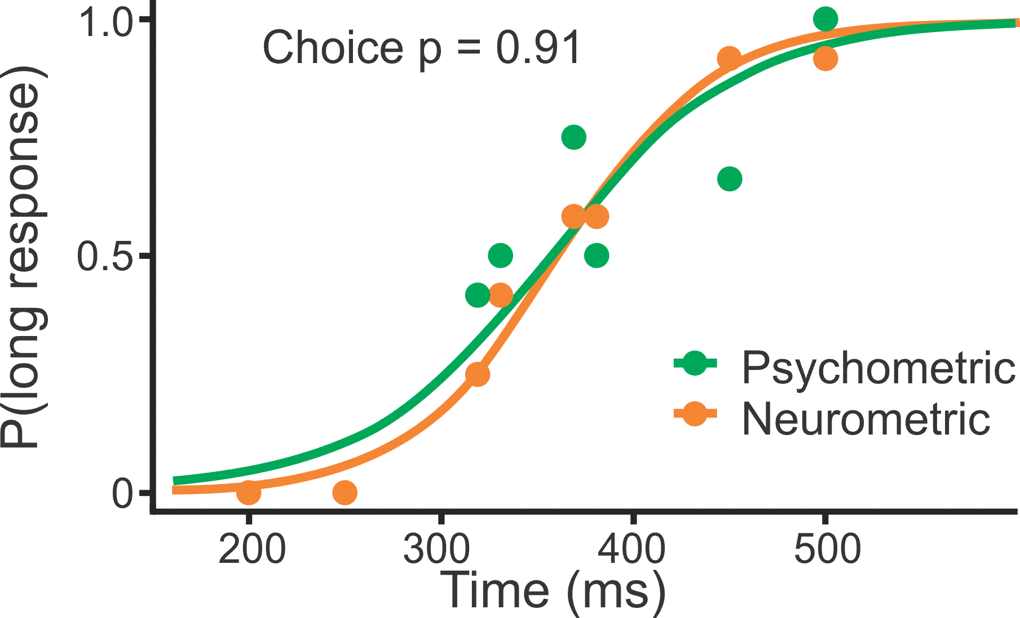
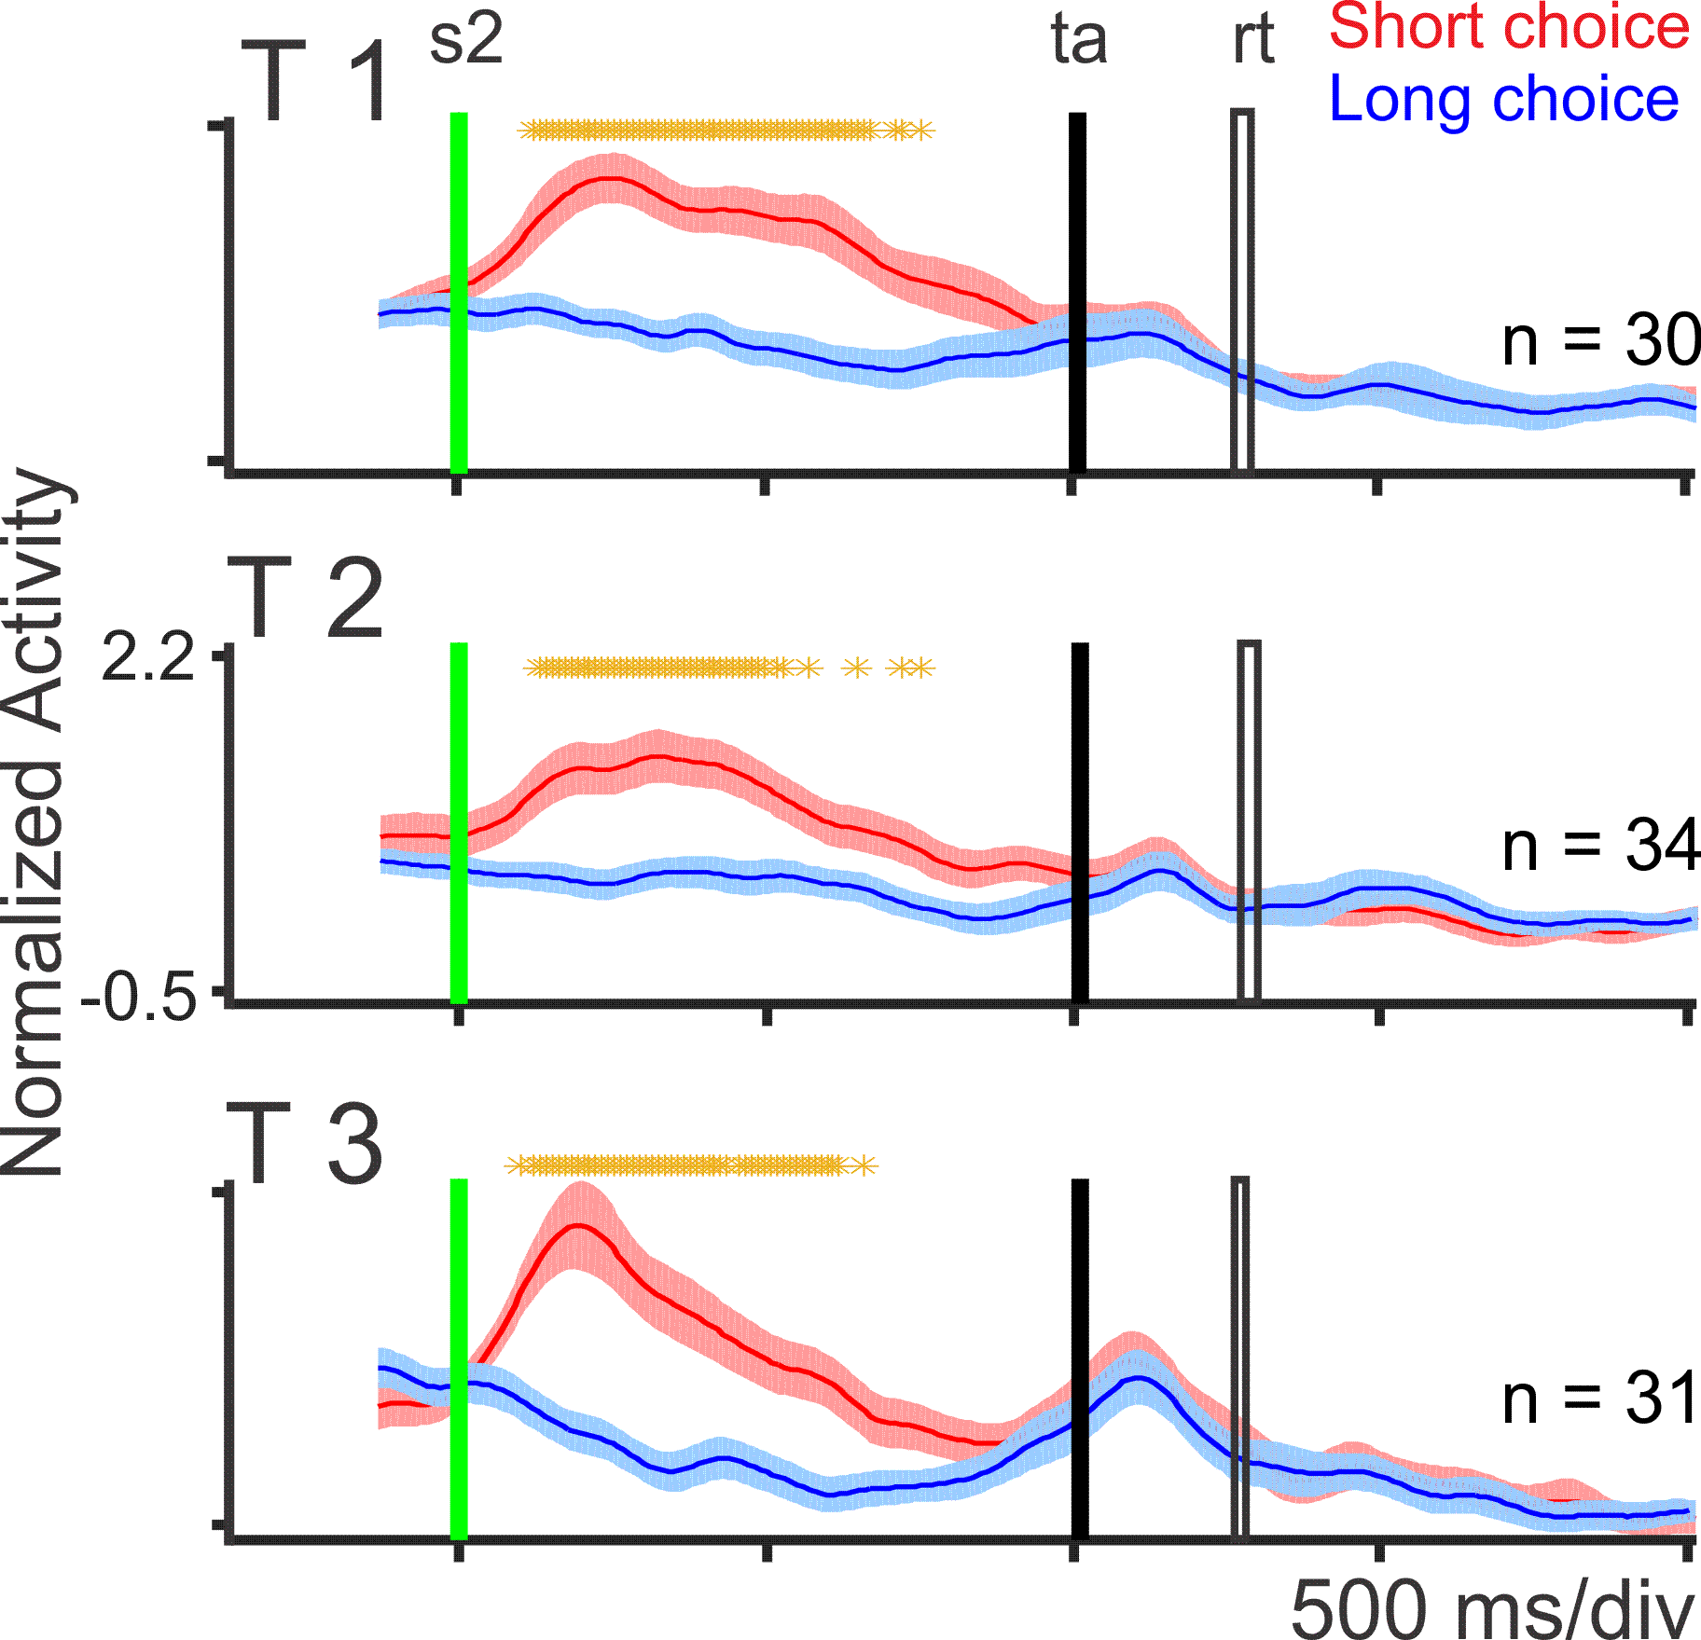
Neural responses related with the categorical decision
Mendoza et al., Nat Commun. 2018

Slide 29
Choice-probability index
The choice-probability index indicates the proportion of behavioral responses that can be predicted from the neuron’s activity. This measure quantifies the overlap between two neural response distributions, in this case between short and long responses.
For each neuron, we constructed two firing rate distributions, one associated to short and another associated to long responses. We employed these distributions to calculate a ROC curve and its area under the curve.
A resulting value of 0.5 indicates a full overlap, whereas a value of 1 indicates a complete separation between the short and long response distributions.

Slide 30
Threshold
Short responses distribution
Long responses distribution
Test Result

Slide 31
Some definitions ...
Short responses distribution
Long responses distribution
True Positives
Test Result

Slide 32
Short responses distribution
Long responses distribution
Test Result
False Positives

Slide 33
Moving the Threshold: left
‘‘-’’
‘‘+’’
Test Result

Slide 34
ROC curve
100%
True Positive Rate (sensitivity)
0%
0%
100%
False Positive Rate (1-specificity)

Slide 35
ROC curve comparison
A good test:
A poor test:
100%
100%
True Positive Rate
True Positive Rate
0%
0%
0%
100%
0%
100%
False Positive Rate
False Positive Rate

Slide 36
Multiple linear regression model using sliding windows of 250 ms with steps of 25 ms:
where r is the discharge rate of the cell, M is the duration of the test interval, C is the categorical choice (short/long), and O is the reward outcome (correct/incorrect).
$r=β_{0}+β_{1}M+β_{2}$C $+β_{3}$O

Slide 37
Poisson spike train analysis

Slide 38
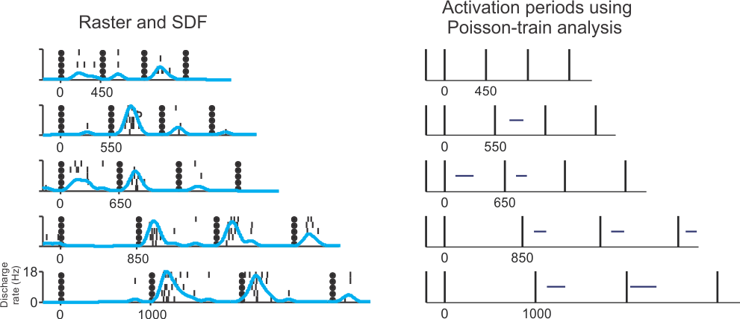
Response-onset and extent of activation periods using the Poisson-train analysis
Merchant et al, Eur J Neurosci 2015.

Slide 40
It has been shown that a distribution of interspike intervals (ISIs) approximates a Poisson distribution, and thus provides a good null hypothesis to detect changes in neuronal modulation
The Poisson spike train analysis determines how improbable it is that the number of action potentials within a specific time interval is a chance occurrence. This is achieved by comparing the actual number of spikes within a time interval to the number of spikes predicted by the Poisson distribution derived from the mean discharge rate during the entire time period in which deviations from randomness are sought.
A measure of improbability is the surprise index (SI), which generates higher values with increasing improbability and is computed with the following formula:
SI=-log P
Thus, a large SI indicates a low probability that a specific elevation in activity was a chance occurrence. P is determined by Poisson's formula:
P= e ^{-rT} ∑ (rT)^{i} / i!
In our analysis, P is the probability that, given a mean discharge rate r, a spike train of a time interval T contains n or more spikes.

Slide 41
The determination of the mean discharge rate, r, is crucial. The goal of the Poisson spike train analysis is to determine whether or not the action potentials within a given interval of time are distributed randomly. In order to achieve this goal, we determined the Poisson distribution of action potentials for a spike train of the same time interval and containing the same number of spikes as the spike train being analyzed. Thus, r was defined as the mean discharge rate of the entire spike train being analyzed.
It is important to note that the Poisson spike train analysis does not operate by finding deviations from some specified baseline level.
The steps of the algorithm are as follows:
1. The mean discharge rate, r, during the trial being analyzed was determined.
2. The program then indexed to the first spike after target presentation and advanced through the spike train until finding the first two consecutive spikes that had a mean discharge rate that was greater than or equal to r. The time between these two spikes was the initial value of T. Then, the next spike was indexed and the ISI between this spike and the previous spike was added to T. The corresponding SI was then calculated. Successive spikes were then indexed and their ISis were added to T until the end of the spike train. The SI was calculated after the addition of each ISI to T. The spike at the end of the interval T with the maximum SI value was defined as the end of the putative burst.

Slide 42
3. Next, the program indexed to the last spike in the spike train, and the SI was calculated for the time interval T from the last spike to the first spike after target presentation. The program then removed spikes from the beginning of the spike train until reaching the spike defining the end of the burst. The spike at which the SI was maximized was defined as the beginning of the putative burst. If the SI from the beginning of the burst to the end of the burst was not significant (p<0.05), the trial was defined as having no burst.
4. To determine the beginning of activation, the SI first was calculated from the end of the burst to the beginning of the burst, and then spikes before the beginning of the burst were added in succession until the SI fell below the desired significance level.
5. To determine the end of activation, the SI was first calculated from the beginning of the burst to the end of the burst, and then spikes after the end of the burst were added in succession until the SI fell below the desired significance level.

Slide 43
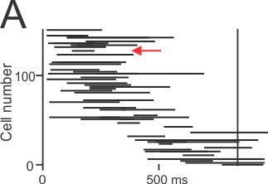
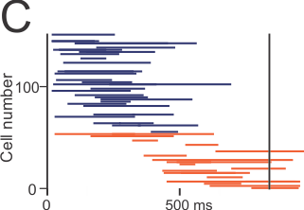
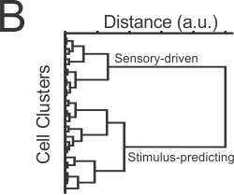
Activation profiles of the Sensory cells: clustering two cell types.
Merchant et al, Eur J Neurosci 2015.

Slide 44
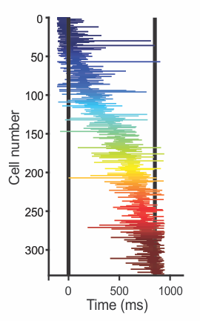
Neural moving bumps
Parameters:
Total number of neurons
Mean activation duration
Mean rate of cell recruitment
Mean firing rate
Gámez et al., 2019, PLoS Biol
Notes:
We measured for each produced interval in the SCT four parameters on the moving bumps.
The total number of neurons, the mean activation duration, the mean rate of cell recruitment, and the mean discharge rate.

Slide 45
Homework
Run the curve fitting, the MI, the choice-P and the multiple linear regression model using sliding windows of 250 ms with steps of 25 ms.
Run a permutation test (100 iterations) to determine the significance level for each coefficient in the models, including the MI and choice-P. For each neuron, permute 100 times de neural activity across the 12 trials and 8 test intervals for each sliding window to obtain a ‘null’ distribution of the coefficients. Use the ‘null’ distribution at 95 % of confidence to determine significant effect for each model.
Determine which neurons encode distance, when and how (linearly or tuned), and which neurons encode categorical decisions, based on the regression and the choice-P.

